Slide 1
Global Terrorism Analysis
By Snigdha Cheekoty

Slide 2
This is still an ongoing project. I have tried showing the visualizations that I worked on till now.

Slide 3
DATA CLEANING STAGE

Slide 4
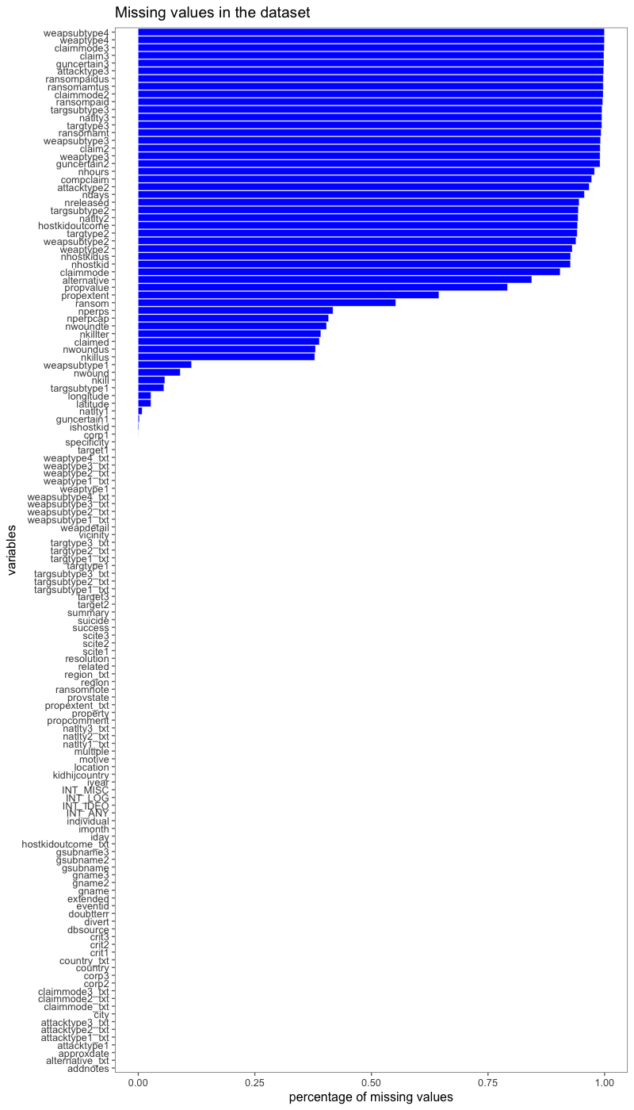
SHOWING MISSING VALUES

Slide 5
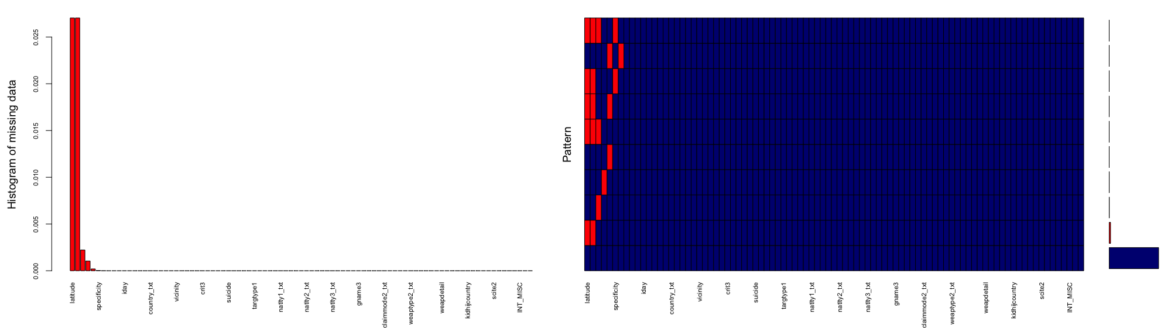
SHOWING MISSING DATA

Slide 6
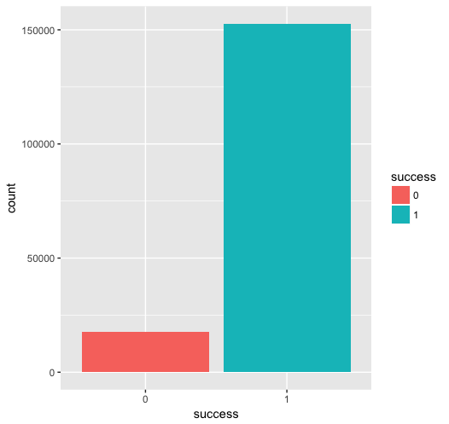
Target variable: “Success”

Slide 7
EXPLORATORY DATA ANALYSIS

Slide 8
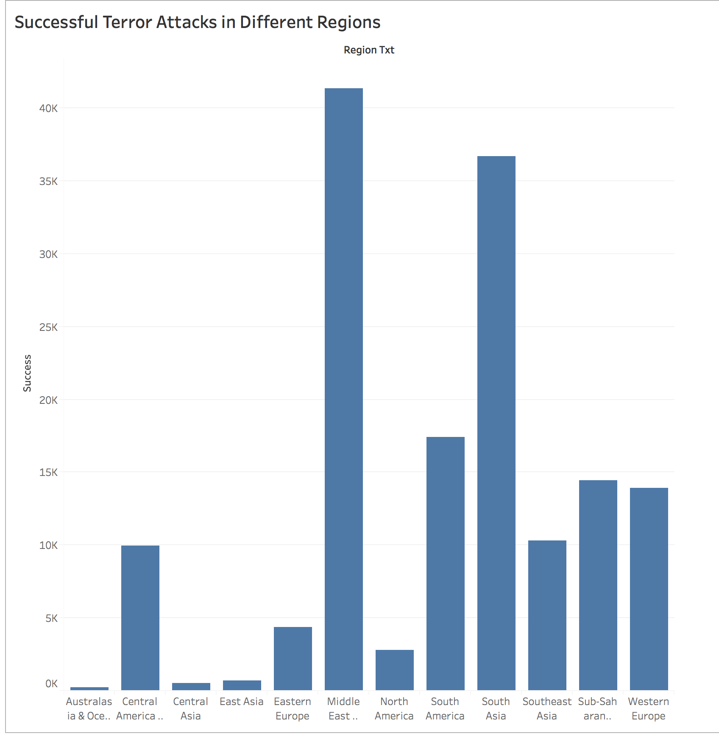

Slide 9
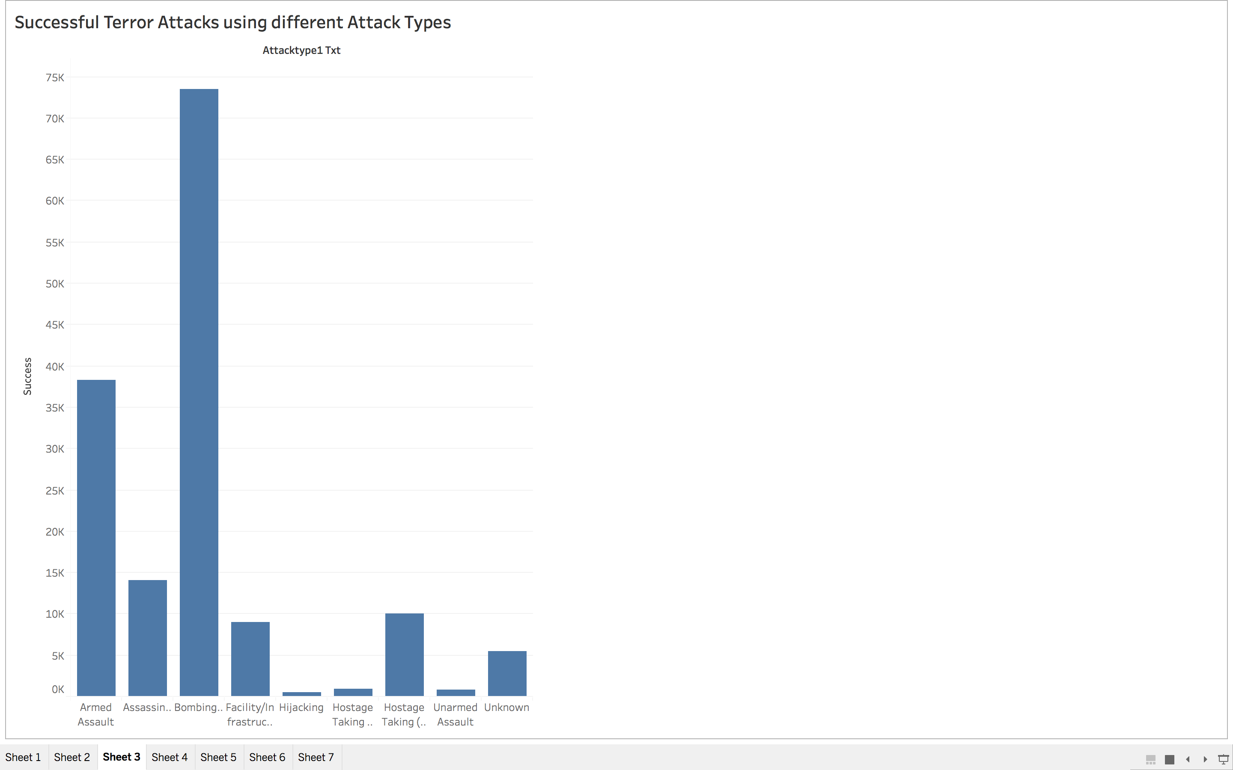

Slide 10
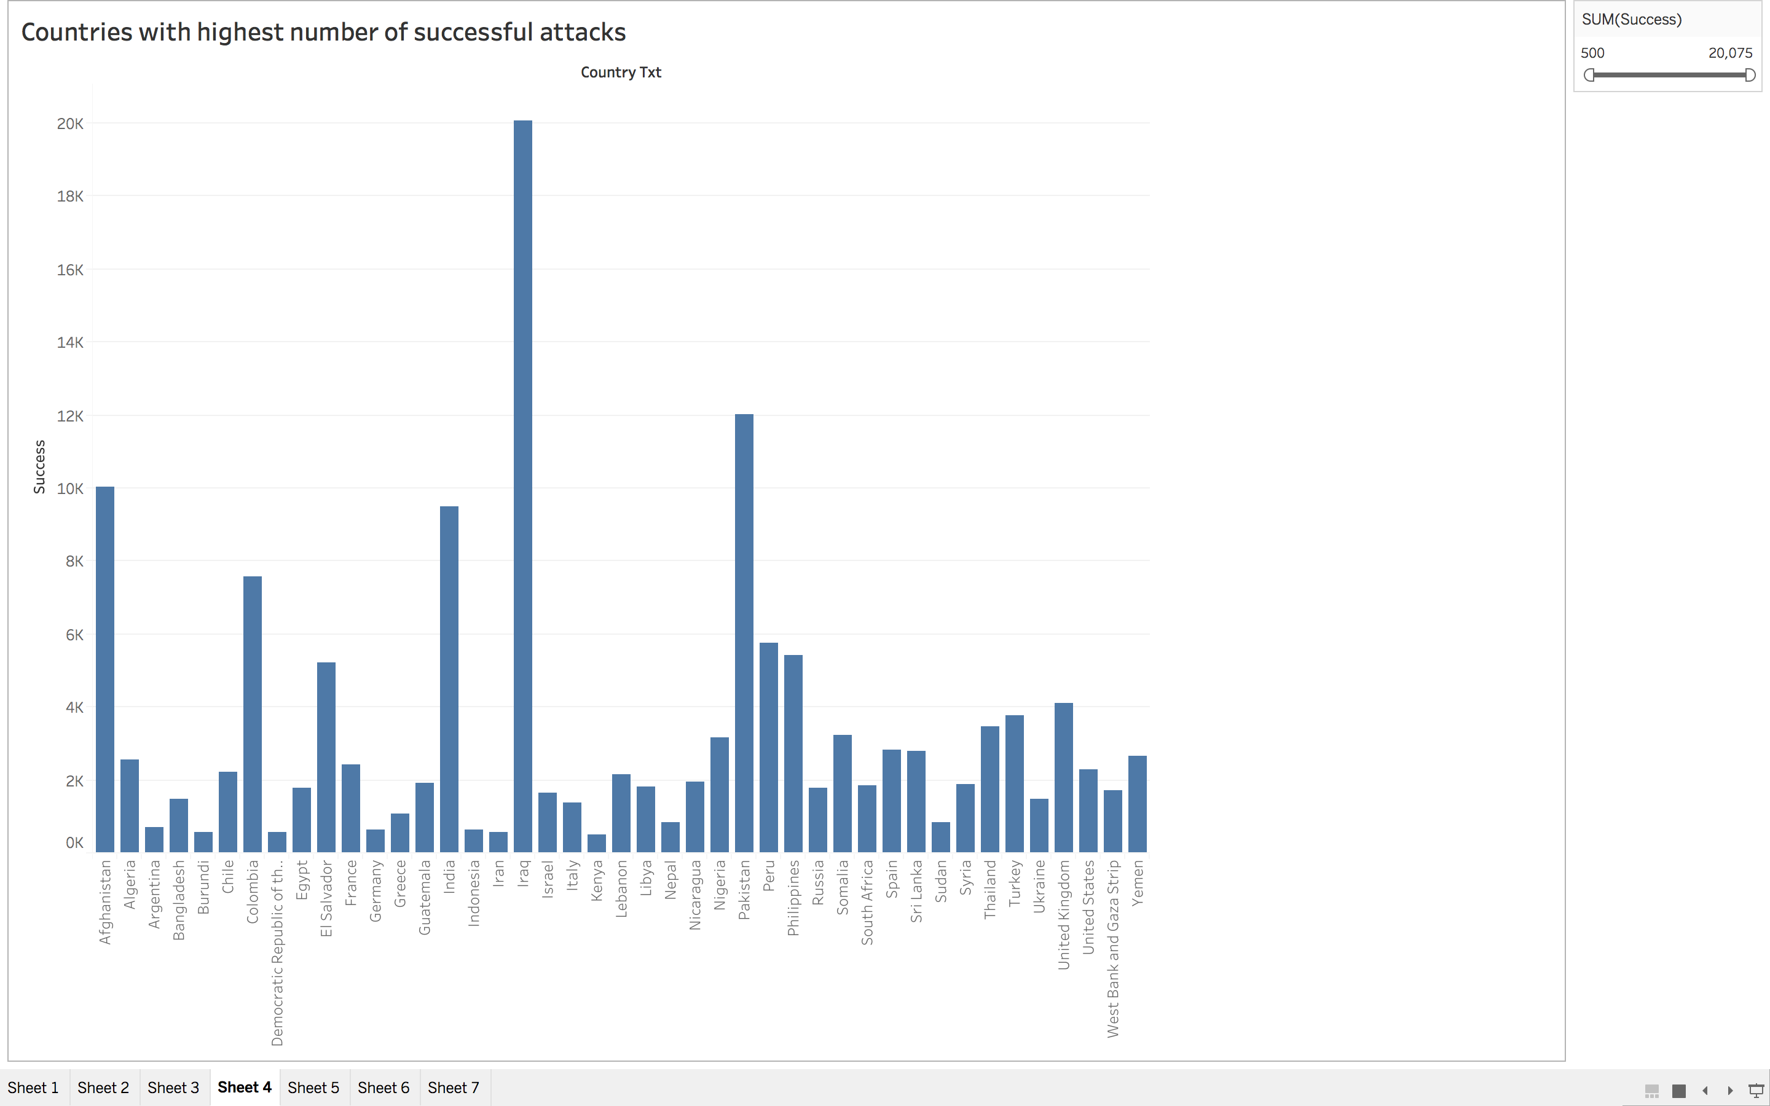

Slide 11
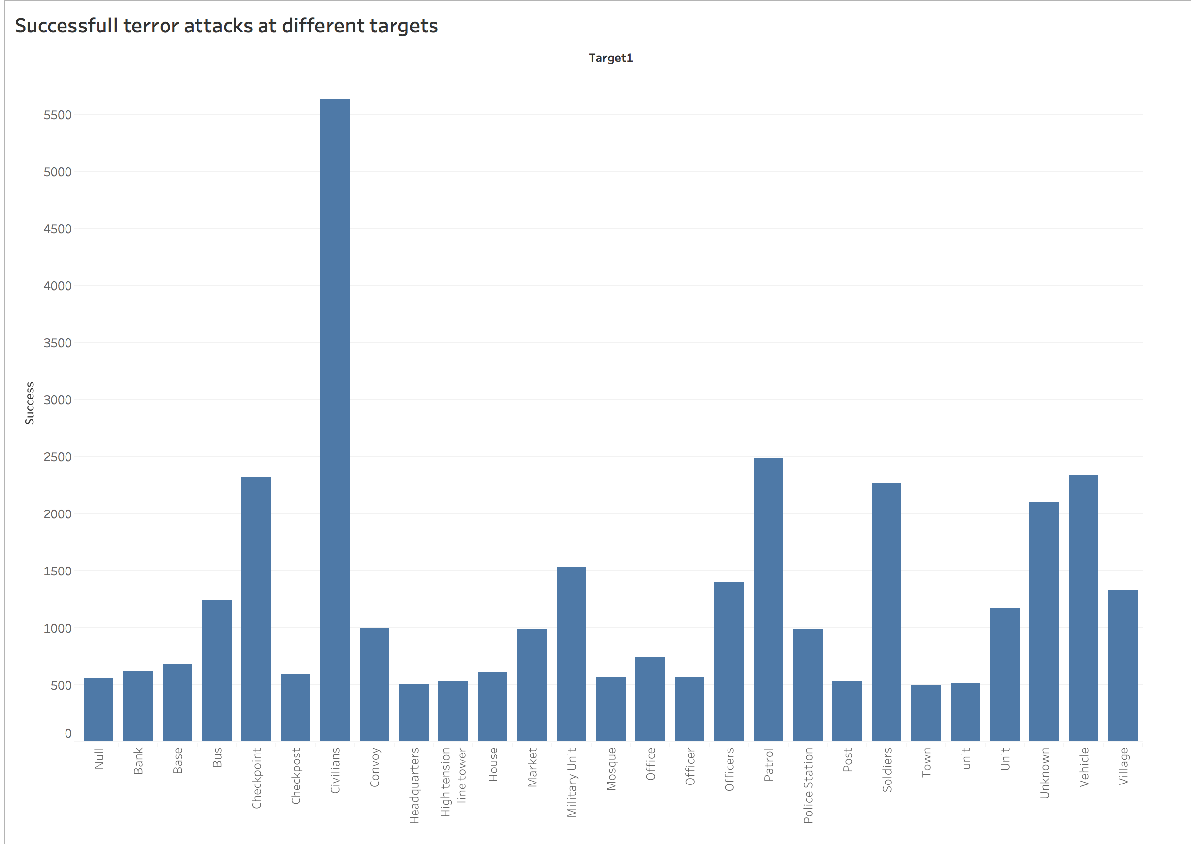

Slide 12
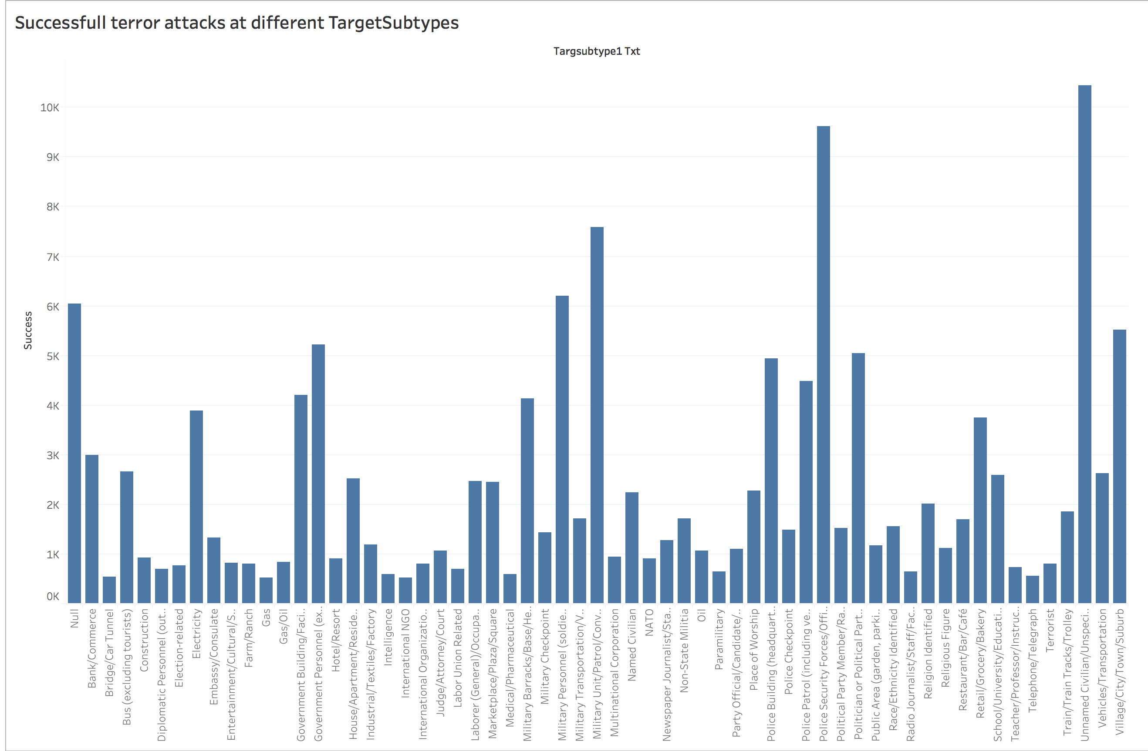

Slide 13
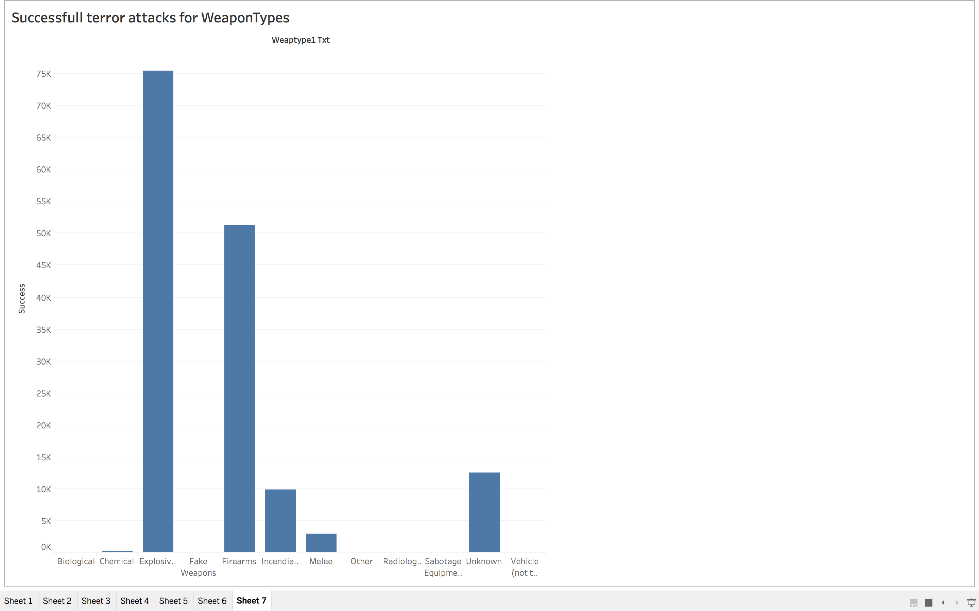

Slide 17
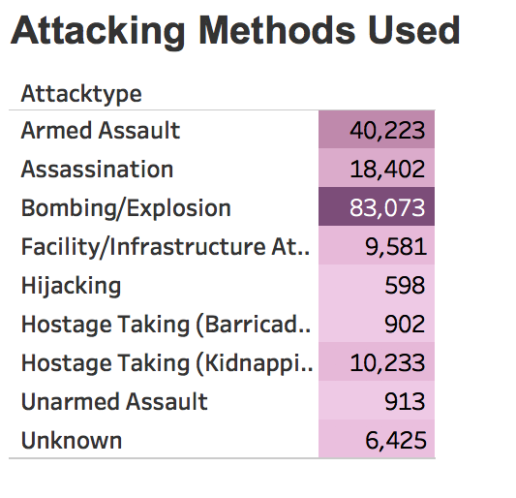
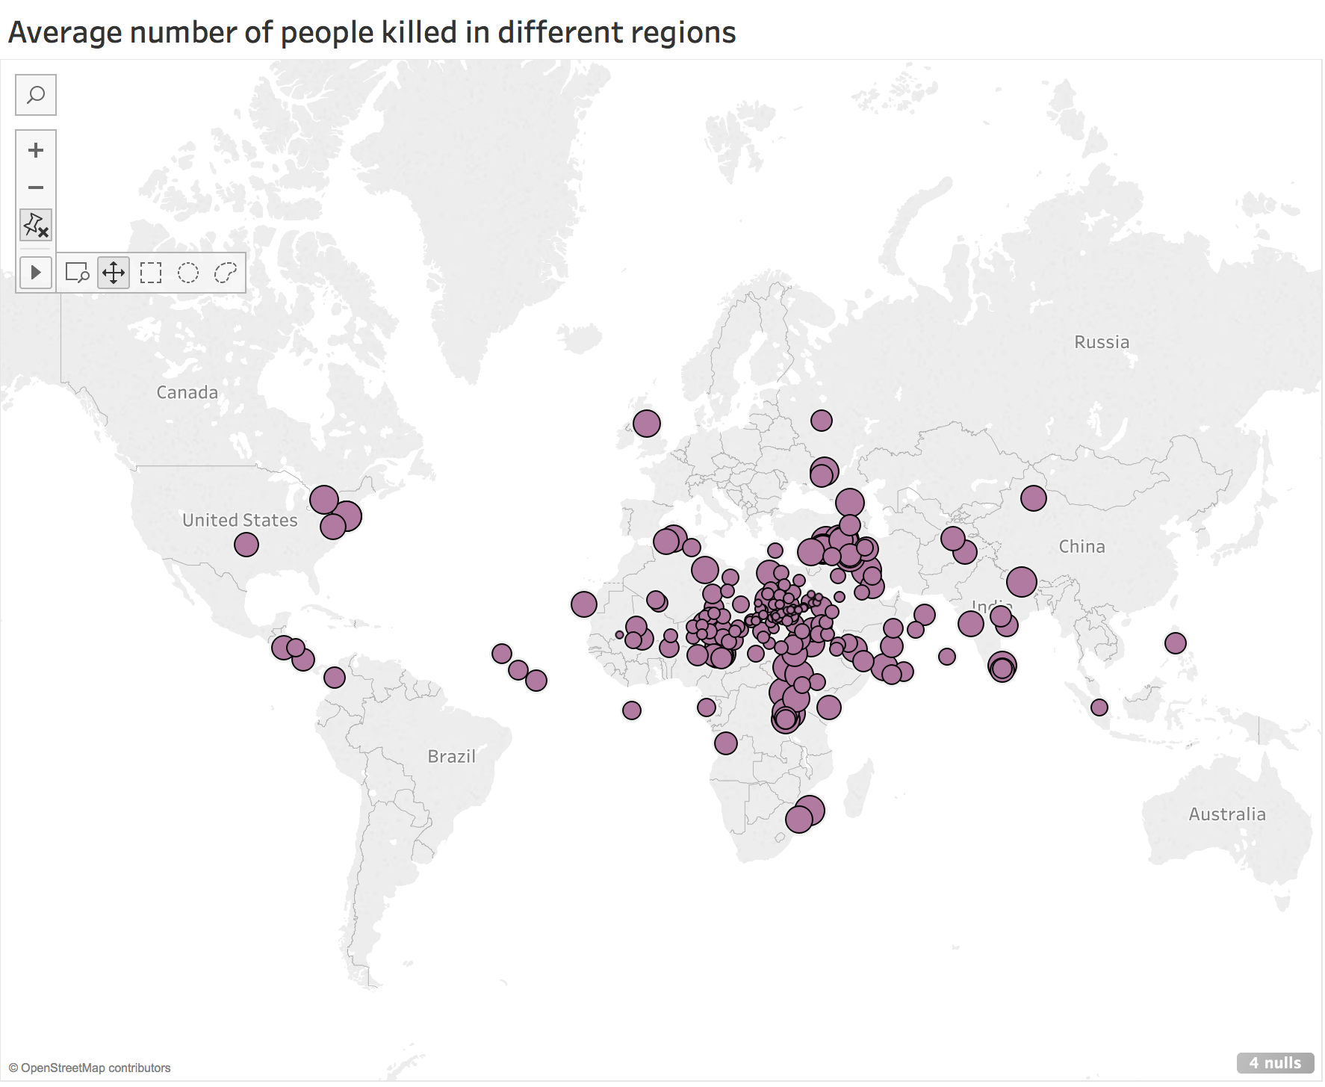

Slide 22
